Slide 1
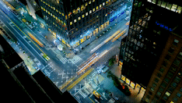
Traffic Control System
Atul Shah
Shreyus Puthiyapurail

Slide 2
Motivation
Increase in population and vehicle density has worsened the traffic situation with the current infrastructure.
We can think of two solutions to this problem.
Expand transportation capacity and build high quality roads which may require significant investment of time and resources.
Improve the existing infrastructure by improving existing Traffic Control Systems.

Slide 3
Challenges in existing Traffic Signals
Inappropriate traffic light sequence. Static predefined policy of sequence can cause long wait times for vehicles at the intersection.
Inappropriate traffic light durations. Static light durations of signal independent of traffic density causes longer queue of vehicles at the intersection.

Slide 4
Solving via RL approach
Use RL algorithm which adapts according to traffic situation (road accident) or bad weather.
RL agents can self-learn without supervision or prior knowledge of the environment.
No need to define complex model to describe the environment as the agent learns from the environment and takes appropriate action.

Slide 5
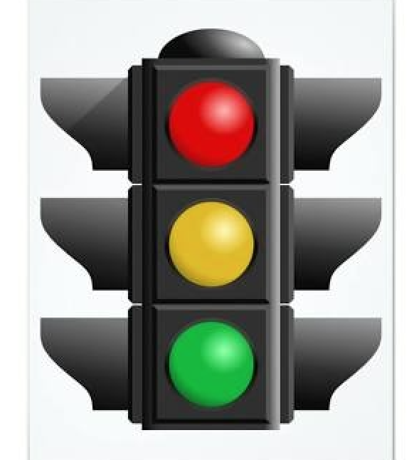
Agent:
Agent is defined as a set of traffic lights that manages the incoming traffic into the intersection.
Traffic Control System is composed of agents that interacts with the environment using a state s, an action a and a reward r.

Slide 6
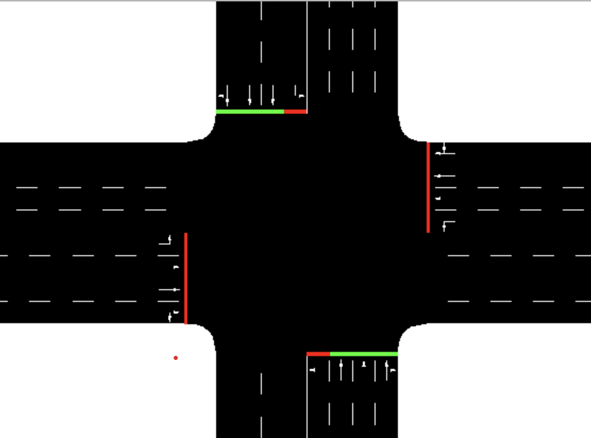
Environment - Simulation of Urban MObility (SUMO)
The environment in which the agent acts is a 4-way intersection.
4 lanes per arm approach the intersection from the compass directions and lead to 4 lanes per arm leaving the intersection.
In the center of the intersection, a traffic light system, controlled by the agent, manages the approaching traffic.

Slide 7
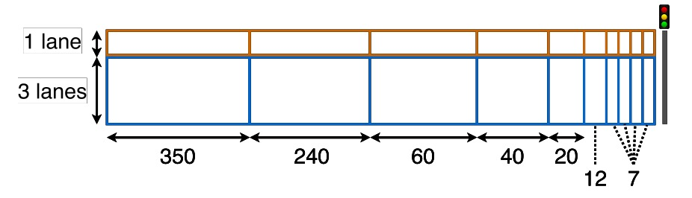
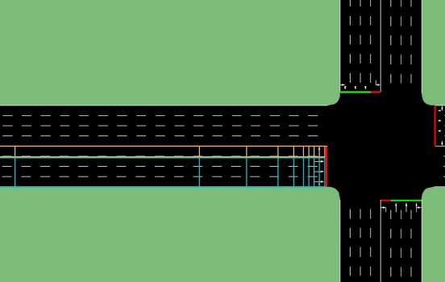
State
The lanes of the intersection are discretized in cells along the length of the lane.
The state of the traffic is represented by cells.

Slide 8


Reward
Defined as a function of performance indicator of the intersection such as vehicle delay, queue length, waiting time or throughput.
Where rt represents the reward at timestep t. twt and twtt−1 represent the total waiting time of all the cars in the intersection captured respectively at timestep t and t−1

Slide 9
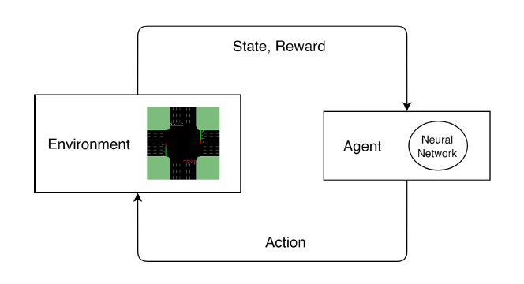
Action
Given the state of s, the agent should choose a traffic light phase a, from a set of actions A, and maximize the rewards r.
A = {NSA; NSLA;EWA;EWLA}

Slide 10
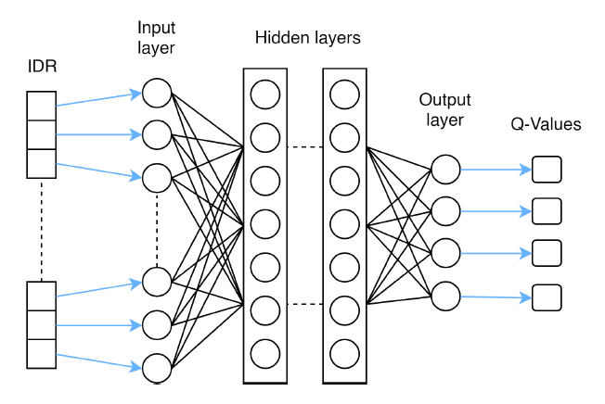
Deep Q-learning
The input of the network is the vector Intersection Discretized Representation (IDR), the state of the environment at timestep t. The outputs of the network are the Q-values of the possible action from state st.
Neural Network
Q-Learning Function

Slide 11
Experience Replay
The randomized group of samples called batch is taken from a data structure, memory which stores every sample collected during the training phase. A training instance involves the gathering of a group of samples from the memory and the neural network training phase.

Slide 12
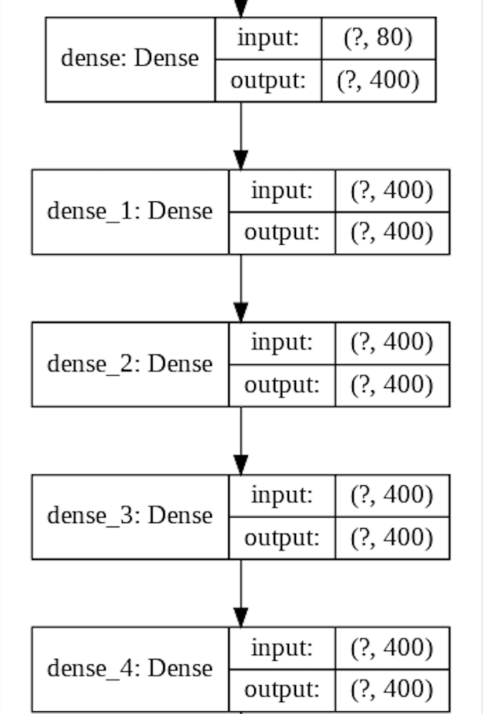
Model Summary
num_layers = 4 width_layers = 400 batch_size = 100 learning_rate = 0.001 training_epochs = 100

Slide 13
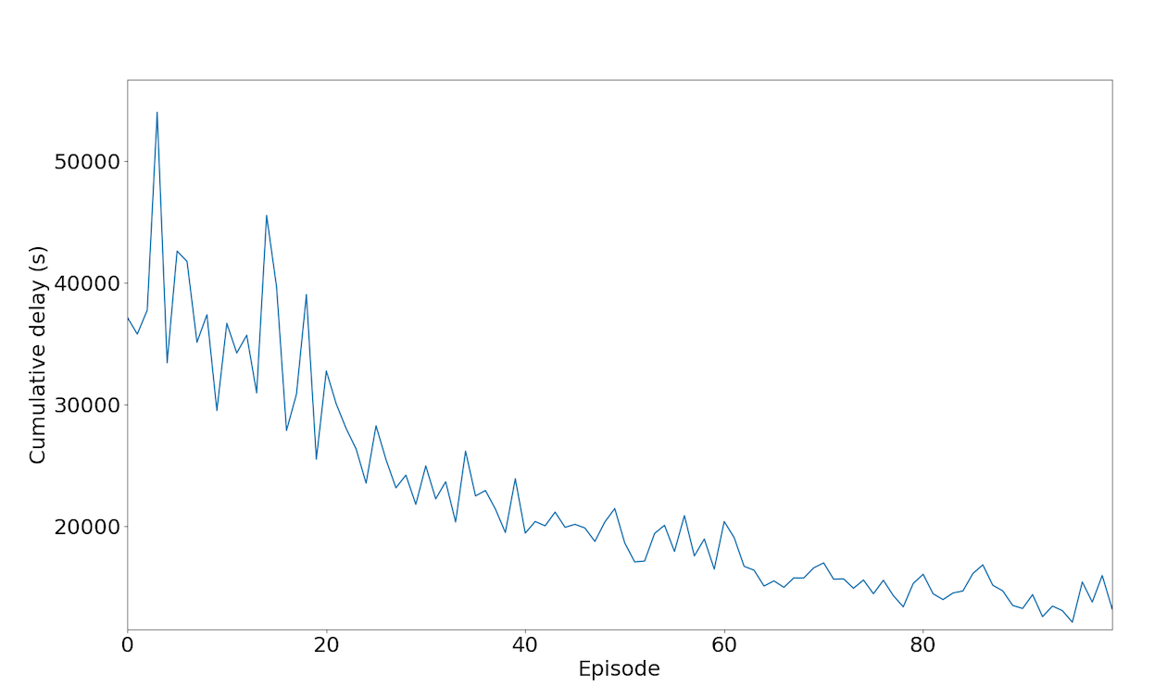
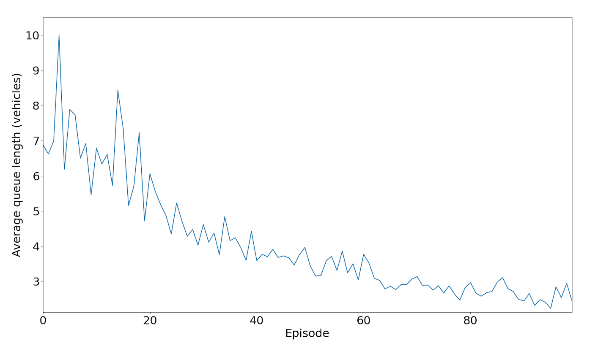
Results:

Slide 14
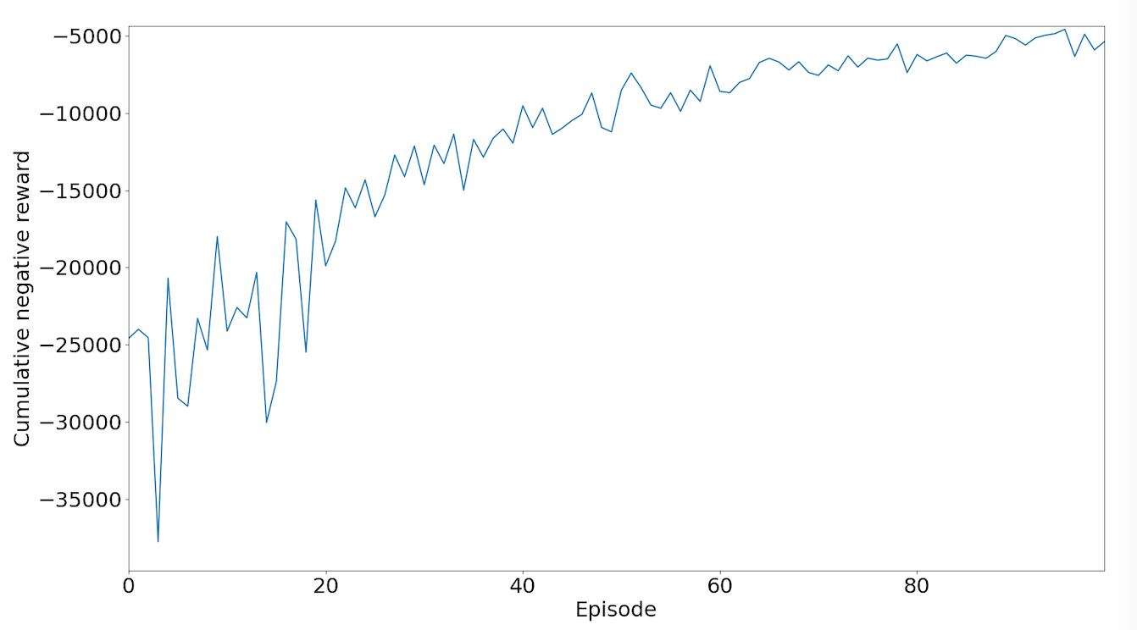
Results:

Slide 15
Code Repository
https://github.com/TrafficControllerRL/TrafficControllerRL

